Slide 1

03
Up solve Assignment

Slide 2
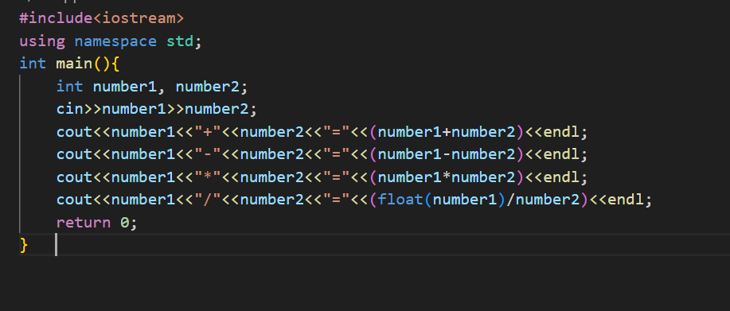
code
A.Problem 1

Slide 3
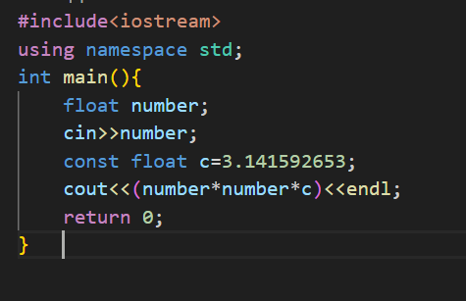
code
A.Problem 2

Slide 4
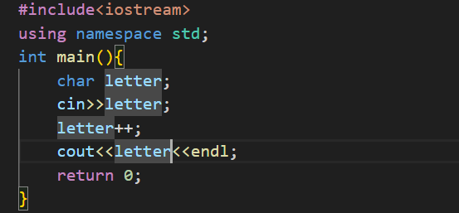
code
A.Problem 3

Slide 5
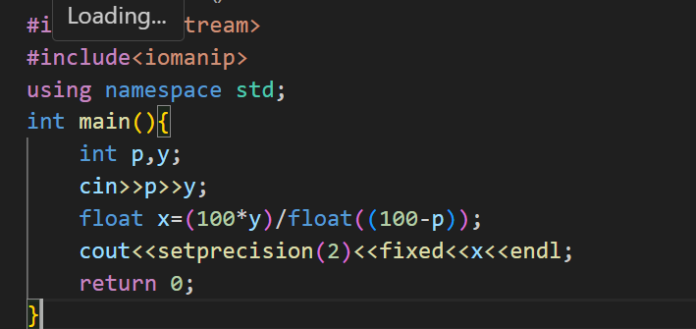
code
A.Problem 4

Slide 6
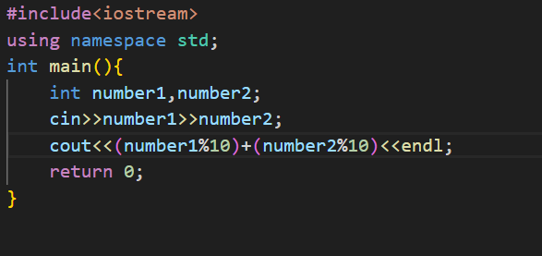
code
A.Problem 5

Slide 7
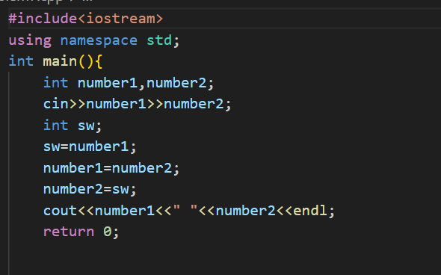
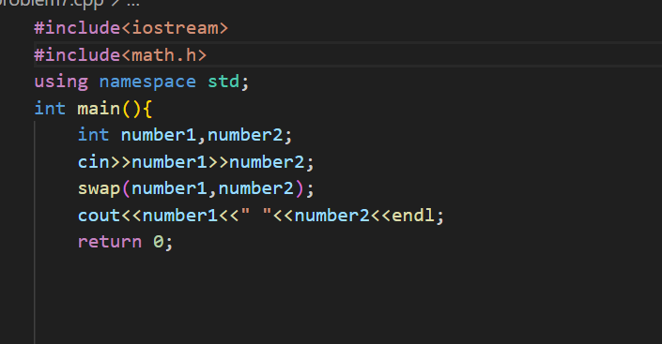
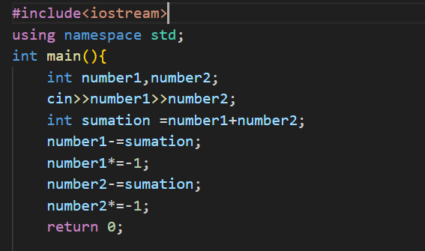
code
A.Problem 6
Method 1
Method 2
Method 3

